Slide 1
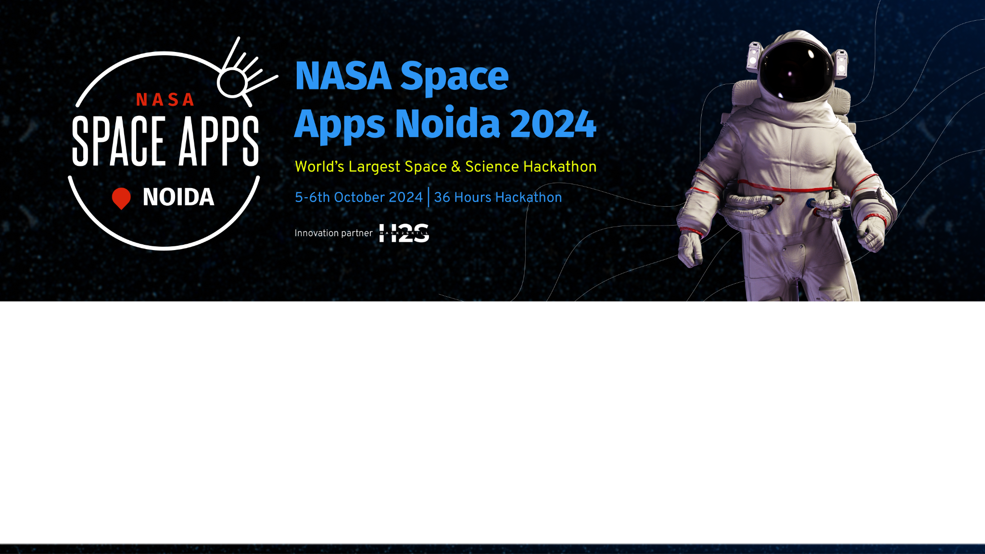
Team Details
Team Name:
b. Team Leader:
c. Problem Statement:
Nebula_space
Soumya Mishra
Show Us What the May 2024 Geomagnetic Storms Looked Like

Slide 2
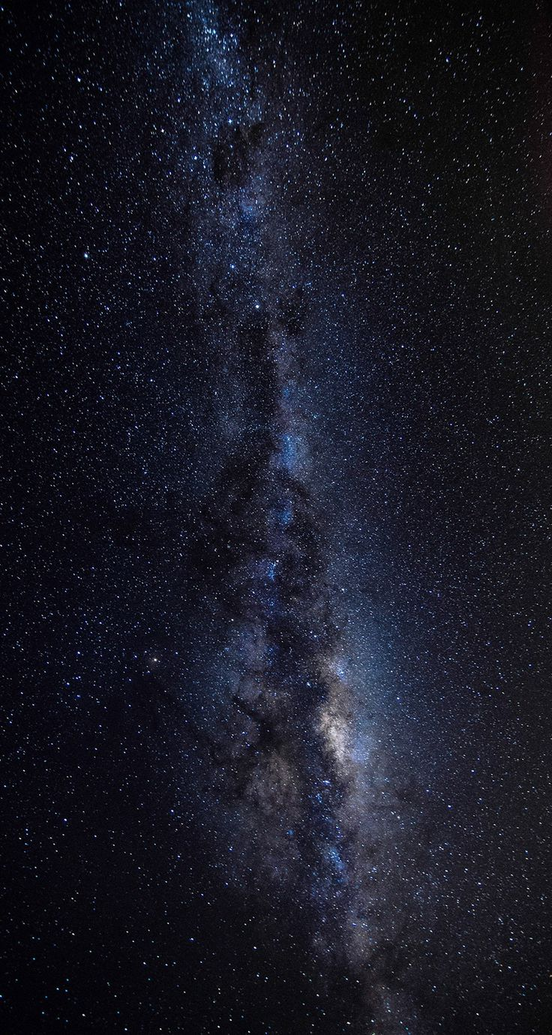
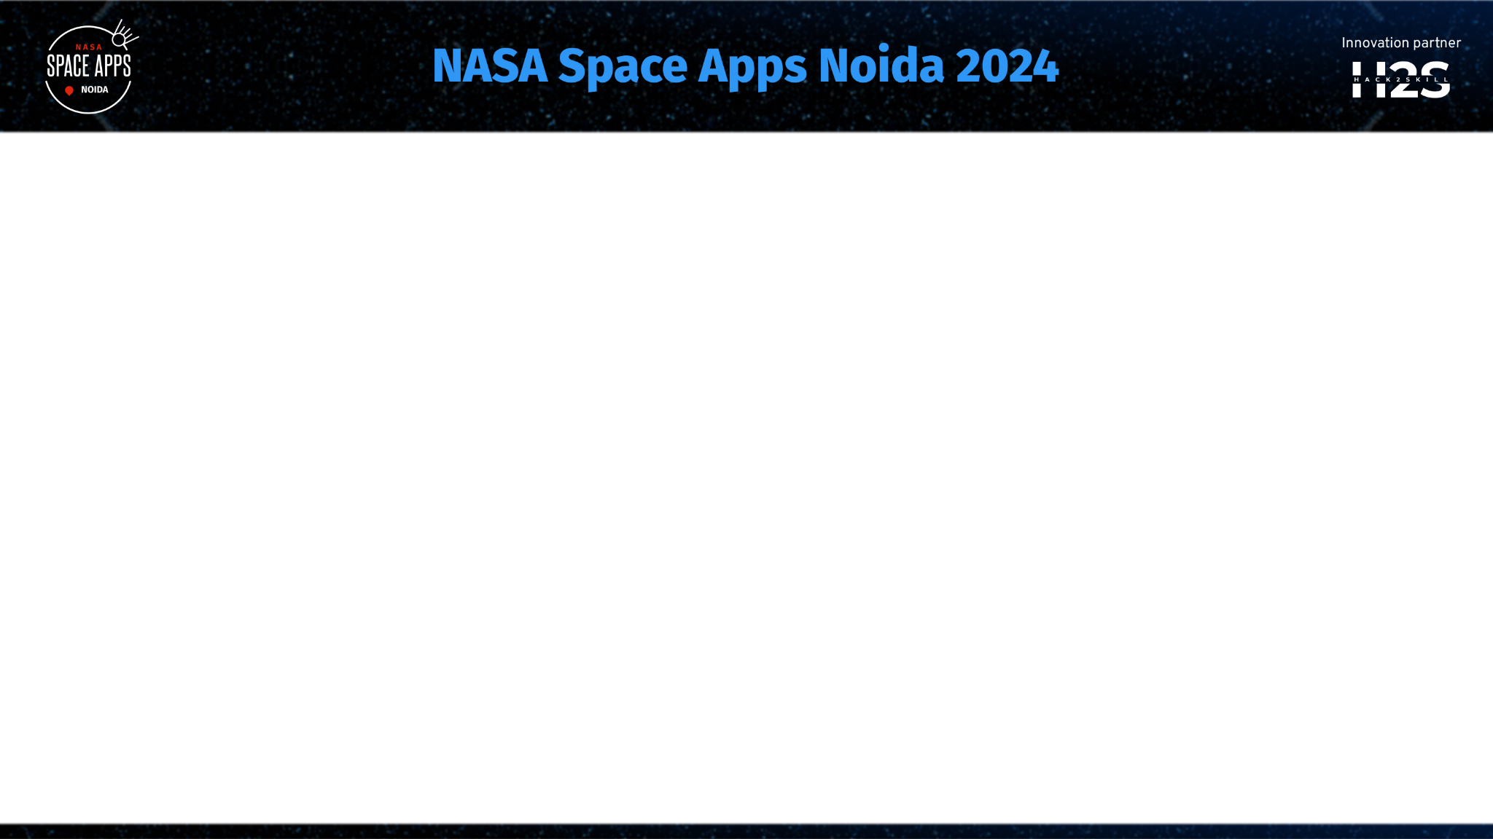
Project Idea: Exploring Solar Storms and the Events of May 2024
The goal of this project is to shed light on solar storms—what they are, how they happen, and the effects they can have on us. These powerful bursts of energy from the Sun can create stunning auroras, but they can also disrupt our technology.
Breakdown of the Project :
Understanding Solar Storms:
We’ll cover the basics of solar storms, including solar flares and coronal mass ejections (CMEs), and explain how they form.
Positive and Negative Effects:
We’ll highlight the breathtaking beauty of auroras and also address the challenges these storms pose, like potential disruptions to satellites, power grids, and GPS systems.
What Happened in May 2024?:
We’ll dive into the specific solar events that occurred in May 2024, using engaging visuals to show the timeline of flares and their impact on Earth.
Importance of the knowledge:
We’ll emphasize the importance of understanding these events, encouraging people to think about how solar storms can affect our everyday lives and technology.

Slide 3
Opportunities :
This project offers valuable opportunities for normal people by enhancing their understanding of solar storms and their effects, thereby improving scientific literacy. It fosters critical thinking and practical skills in data interpretation while promoting community discussions that build connections and collaboration. Additionally, it can inspire interest in science and technology careers, leading to mentorship opportunities with educators and professionals.
How different is it from any of the other existing ideas?
The proposed project will describe the occurrence of the solar storms, impact as well as the phenomena of May 2024 Solar Storm in ions or rays point of view rather than a human being merely describing the event. It will also tell that how the solar storm is affecting earth today also. As according to NASA the storms will be hitting on 5th and 6th October.
How will it be able to solve the problem?
This project will address the challenge of understanding solar storms by providing a comprehensive and engaging educational experience. By breaking down complex concepts into accessible information. Visual aids, such as images, data visualizations, will help illustrate key points, making the information more relatable and easier to grasp. The project will create a personal relevance that enhances understanding, and promotes understanding among people about the phenomena that they are expriencing every now and then but doesn't know about it.
USP of the proposed solution : This project empowers individuals to not only understand these cosmic events but also appreciate their real-world significance.

Slide 4
Features Offered
1.Accessible Learning Materials: Simplified explanations and engaging content ensure that participants of all backgrounds can understand and grasp complex solar storm phenomena.
2. Literacy Enhancement: The project promotes scientific literacy by providing foundational knowledge about solar storms and their impacts, making participants more informed citizens.
3. Visual Aids: Use of graphs, images and infographics makes complex data visually appealing and easier to comprehend, facilitating better understanding.
4. Community Discussions: Encourages open dialogue among individuals, fostering a collaborative learning environment where diverse perspectives enrich the conversation and different knowledge will be gained.
5. Tailored Content for Diverse Audiences: The program addresses the varying levels of knowledge among participants, ensuring that everyone—from students to adults—can engage meaningfully with the material.
6. Real-World Implications: Focus on how solar storms affect technology, environment, and daily life, making the topic relevant to different people and their experiences.

Slide 5
Flowchart
Input Data
NASA Official Data and Other Resources
Data Processing
Extract and Analyze
Content Creation
Visualizations, Narrative, Visual Aids
Output
Final Proposed Video/Movie
User Interaction
Display Information, Interactive Way of Understaing the Context

Slide 6
Architectural Diagram
Start
Discussions
User Interface
Visual Aids
Access Learning Materials
Educational Content Database
Knowledge Gained

Slide 7
Technologies used for the Visual Story
Animation and Video Editing Tools:
Adobe After Effects: For creating dynamic animations and visual effects.
Camtasia: For screen recording and video editing, allowing for interactive video content.
Virtual and Augmented Reality Tools
Unity with AR/VR SDKs: For developing immersive virtual or augmented reality experiences that allow users to explore solar storm phenomena interactively.
Blippar: A platform for creating augmented reality experiences that can enhance storytelling.
Web-Based Interactive Storytelling
Webflow: For designing responsive websites that can host interactive stories with animations.
HTML5 and JavaScript Libraries: Such as GSAP (GreenSock Animation Platform) for creating smooth animations and interactivity on the web.
Audio and Sound Editing
Audacity: For editing audio to create engaging narrations or sound effects.
GarageBand: For creating soundtracks or background music to enhance the storytelling experience.
Interactive Units
Google Earth Engine : Layer Storm data on geographical maps.
Space weather live: Current Geomagnetic Data

Slide 8
Provide links to your:
GitHub Public Repository : Working on it
Demo Video Link (3 Minutes) : Half Ready (Working on it)
Final Product Link : Working

Slide 9
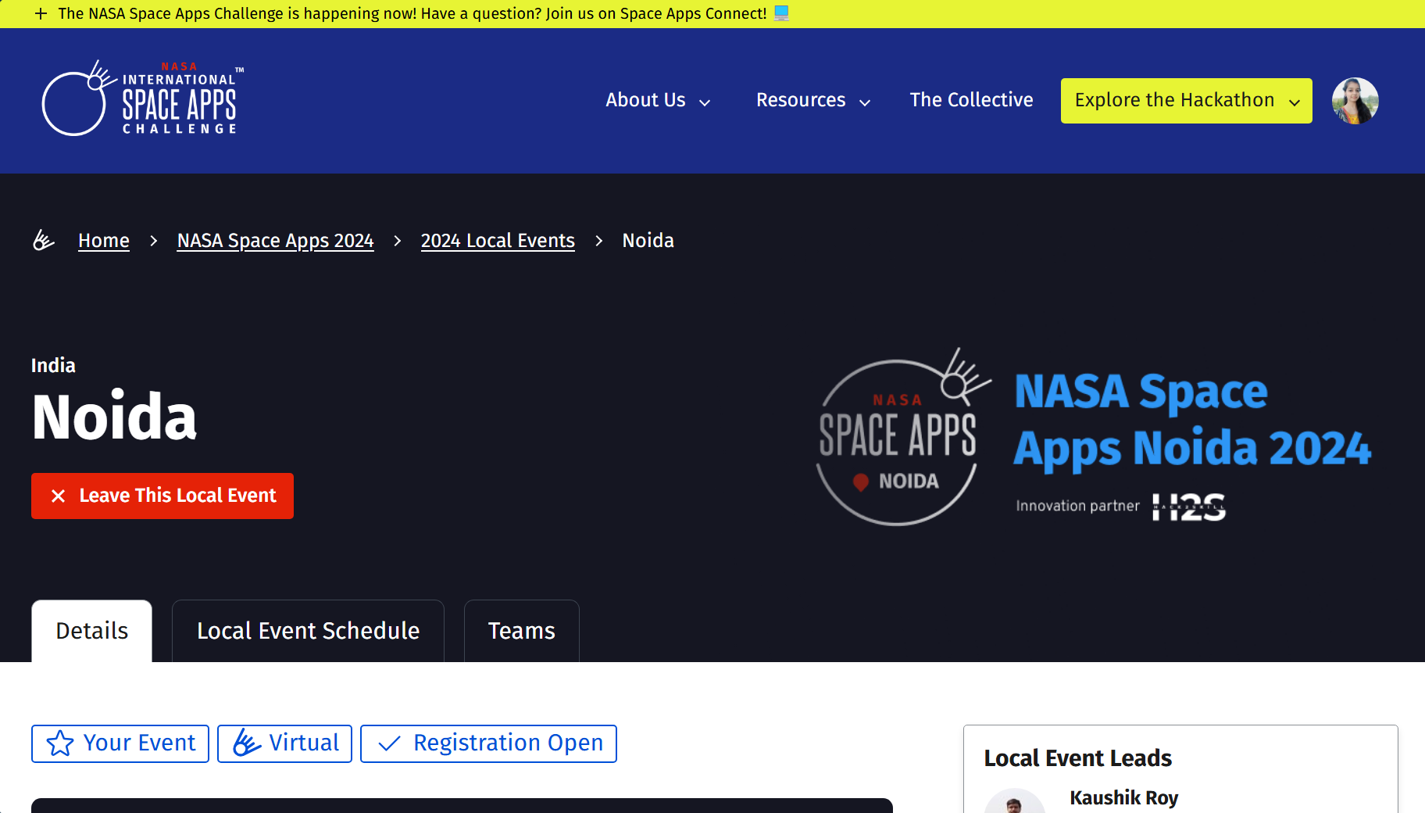

Slide 10
